Slide 1
iOS Training

Slide 2
Sources
https://fpt-software.udemy.com
https://stackoverflow.com
https://medium.com
https://www.kodeco.com/home raywenderlich
https://www.appcoda.com/ios-programming-course/
https://github.com
https://github.com/kodecocodes/swift-algorithm-club
https://github.com/mattneub/Programming-iOS-Book-Examples
https://github.com/soapyigu/LeetCode-Swift
https://github.com/uraimo/Awesome-Swift-Playgrounds
https://github.com/ioscreator/ioscreator

Slide 3
Github
Languages: swift
Sort by: Most stars, Recently updated …

Slide 4
stackoverflow
https://stackoverflow.com/questions/tagged/uicollectionviewlayout
Filter -> Sorted by

Slide 5
medium
medium + keyword

Slide 6
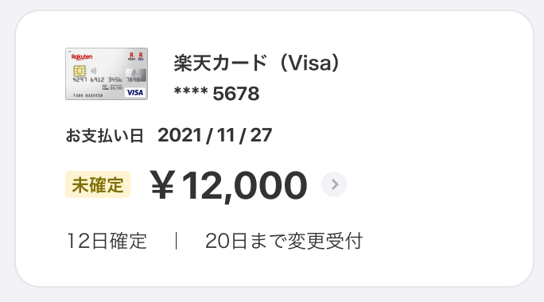
View layout
Top -> bottom
Left -> right

Slide 7
View layout
Background view
Content view
Top view
Middle view
Bottom view

Slide 8
Autolayout
Flexible
Unchanged
Screen size
Debug autolayout

Slide 9
How to add constraint
Left to right
Right to left
Top to bottom
Bottom to top

Slide 10
iOS Resolution
https://www.ios-resolution.com

Slide 11
Choosing right control
Content size not over view size
View
Content size over view size
Horizontal: scrollview, collectionview, pageviewcontroller, stackview
Vertical: scrollview, tableview, collectionview, stackview

Slide 12
Coding conventions
https://github.com/eure/swift-style-guide
https://github.com/kodecocodes/swift-style-guide
Class name: UpperCamelCase
Function name: lowerCamelCase
Enums: lowerCamelCase

Slide 13
Declare
Paramter:
var item: Item? = nil
Function:
func remove(at index: Index) -> Element
Array:
let array = ["Hello", ”World"]
var array: [String] = []

Slide 14
Force Unwrap
if let object = objectOrNil {
// do something with unwrapped object
}
guard let object = objectOrNil else {
return
}
// do something with unwrapped object

